Slide 1
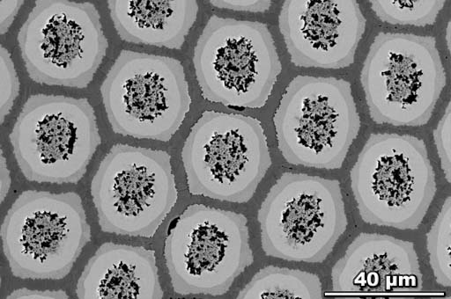
Minimum wall thickness macro
This demo uses a 15 year old image of a strand that was manufactured by a company now out of business.
I wanted to use this example in a publication without any commercial issues.
This Powder-in-Tube ("PIT") has Sn-rich powder cores that supply Sn for the outward reaction of the Nb(Ta) tube to superconducting Nb₃Sn.

Slide 2
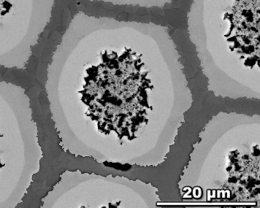

Analysis of interest: unreacted tube thickness
Nb(Ta)
Cu
Nb₃Sn
In some of our tubes the tube has reacted through so the minimum unreacted tube thickness is zero
Thresholded unreacted tube (wall) (broken ring)
React-through

Slide 3
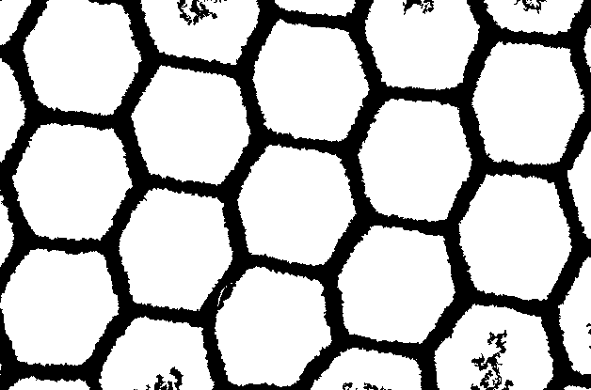
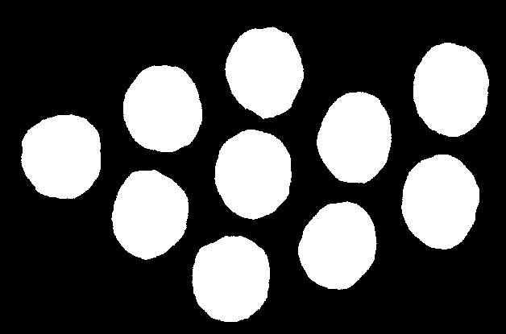
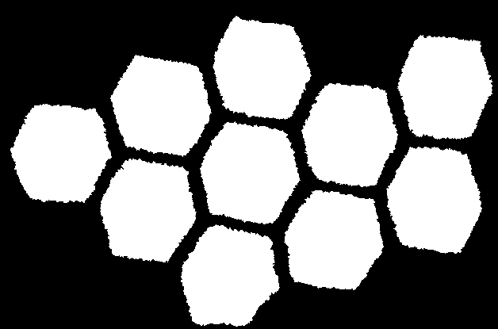
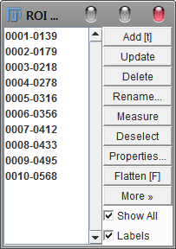
Analysis Steps (before running macro): Broken Rings
Start with thresholded full objects (tubes, cells etc.).
Also create image of inner objects (source of inner outline).
This allows zero-thickness measurements (broken ring)
If the outer image filename has "_outer" in the name and this is replaced by "_inner" for the inner image the _inner image will be loaded automatically
Remove Edge Objects i.e. morphology/KillBorders
Run ImageJ Analyze Particles or the Gabriel Landini Particles4/8 to obtain ROIs in the ROI manager (if there are no roi objects the macro will ask if you want to run Analyze Particles).
If you leave the Results Table open the statistical data will be added to new columns to the right. If you have previously closed the Results Table a new one will be created with the new columns only.

Slide 4
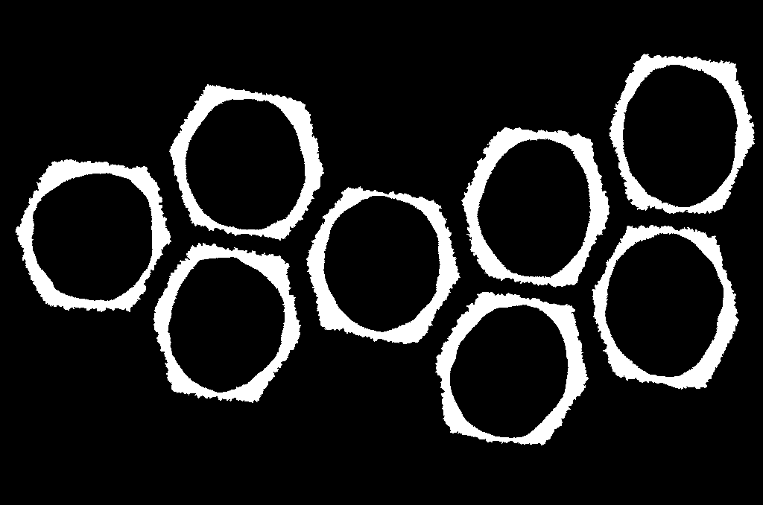
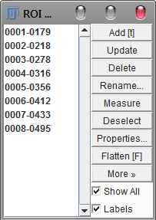
Fewer Steps for Continuous Rings
Start with thresholded full rings.
Run ImageJ Analyze Particles or the Gabriel Landini Particles4/8 to obtain ROIs in the ROI manager ((if there are no roi objects the macro will ask if you want to run Analyze Particles).
If you leave the Results Table open the statistical data will be added to it. If you close it Results Table a new one will be created for the statistics as well as a separate results table containing all the minimum distances.

Slide 5
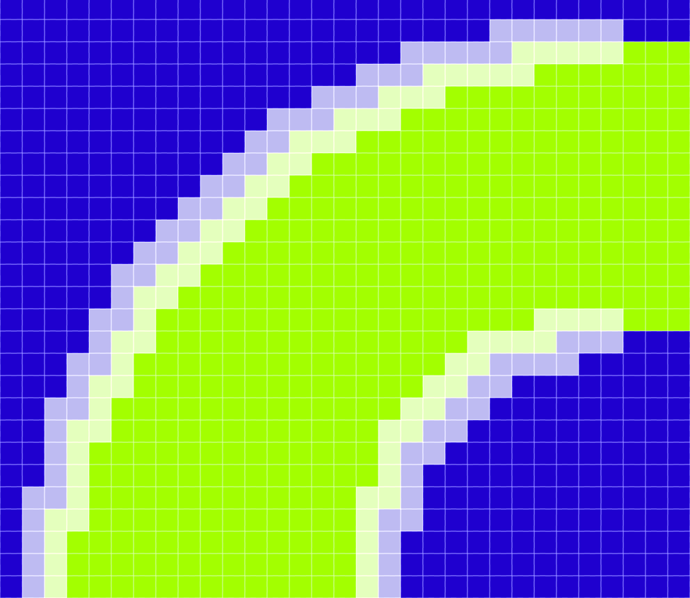
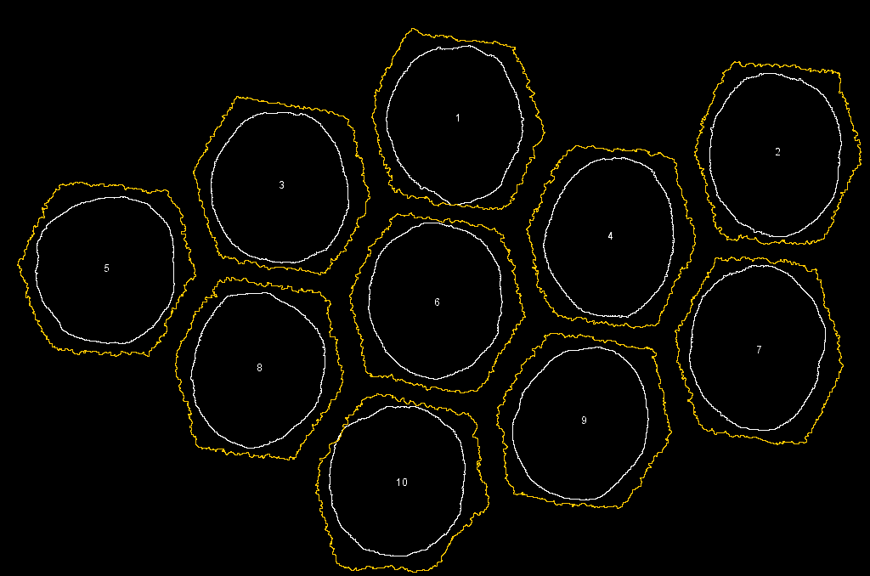
Macro: non-"ring" versions
Run Macro . . .
There are 2 main variants
Outwards (our diffusion direction).
Inwards (Osmosis?).
For the "Ring" versions you will be requested to load the file containing the image of the cores (inner objects). The macro will convert to 8-bit and threshold if not already in this format.
In the "+options" versions you will be asked if you want to skip some of the "from" points (all "to" points will be retained to maintain resolution).
Outline
In-line
Outline
In-line

Slide 6
8 Basic Variants
Outline
In-line
Inwards using object Outlines
Inwards using object "In-lines"
Outwards using object Outlines
Outwards using object "In-Lines"
Rings (faster if no breaks) Inwards using object Outlines
Rings (faster if no breaks) Inwards using object "In-lines"
Rings (faster if no breaks) Outwards using object Outlines
Rings (faster if no breaks) Outwards using object "In-Lines"
Outline
In-line

Slide 7
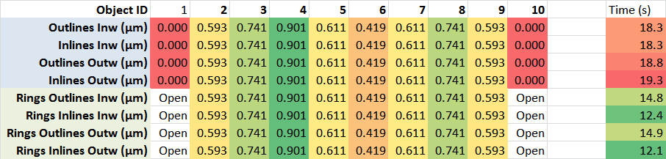
Does it matter which version: Minimum Thickness
For the PIT example it does not matter.
The "Rings" version is faster but cannot record the thickness values for incomplete rings (objects 1 and 10)

Slide 8
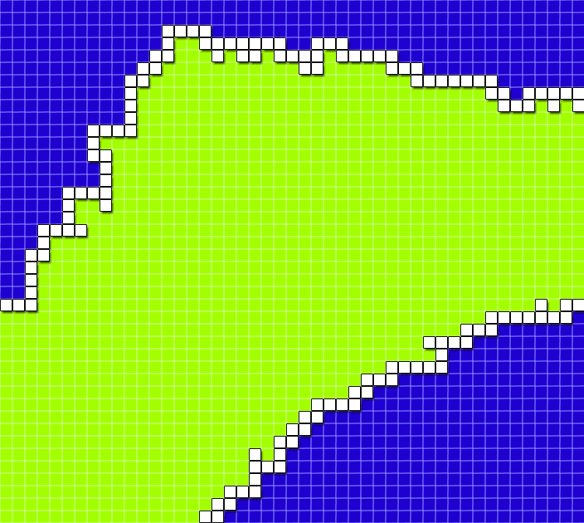
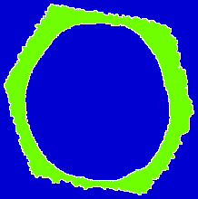
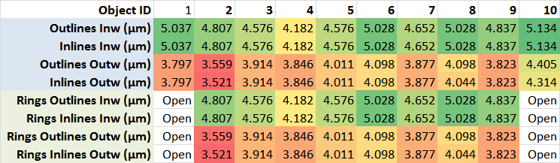
Does it matter which version? Maximum Thickness
For the PIT example it does matter.
In this "PIT" example the outward "maximum" thickness is significantly shorter.
Inwards forced to longer path
Outwards ignores thick corners

Slide 9
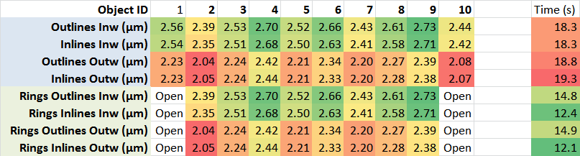
Does it matter which version? Mean Thickness
For the PIT example it does matter.
In this "PIT" example the outward "maximum" thickness is significantly shorter.
Very small differences between "Outline" and "In-line" perhaps due to sampling.
Inwards forced to longer path
Outwards ignores thick corners

Slide 10
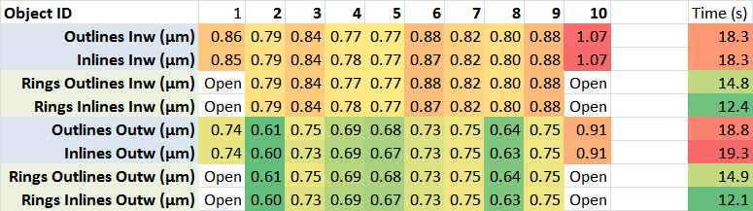
Does it matter which version? Std. Dev
For the PIT example it does matter.
In this "PIT" example the outward variation is small because it ignores the thick outer corners.
Very small differences between "Outline" and "In-line" perhaps due to sampling.
Inwards forced to longer path
Outwards ignores thick corners
Note: changed order of methods in table

Slide 11
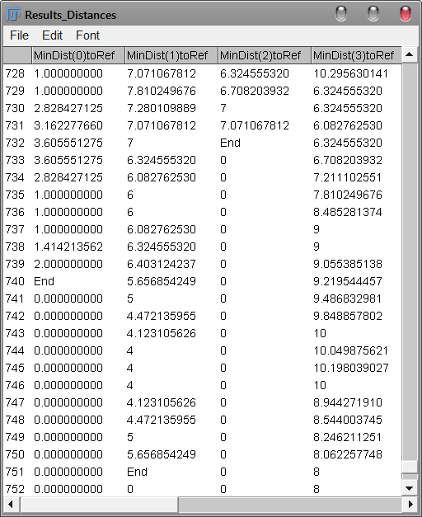
Output: "Results_Distances"
All the minimum distances from each pixel are save for future analysis using a Results table (switching between tables slows the macro down but it is nice to have the originals.
The results table expands unfilled rows with zeros so it marks the end of the real data with "End"
The results are scaled with a unit if a measurement scale is set.
It adds <10% to the run time to keep this full result set.

Slide 12
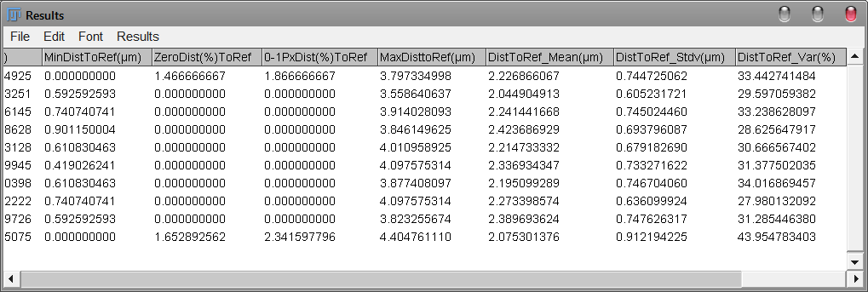
Output: "Results"
Summaries of the results are added to the existing or to a new table if the original table has been closed.
For the non-Ring versions the % of zero thickness is recorded.

Slide 13
Summary
Performing these analyses using arrays within ImageJ/Fiji is very fast compared to VB-macros in Excel.
A variety of analysis can be performed based on the direction of diffusion/osmosis and type of layer.
ImageJ macros are easy to edit to perform additional functions.
"+options" versions simplify choices and allow faster operation by skipping data points but these versions will not be so easy to adapt for unattended batch operation.

